Slide 1
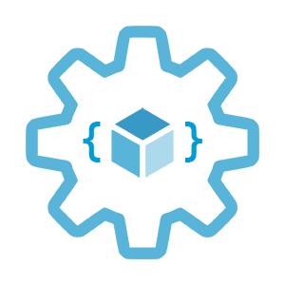
Implement immutable infrastructure on Azure with ARM templates
Infrastructure as Code User Group Oslo
26.05.2020
Evgeny Borzenin

Slide 2
Agenda
17:05 – start
Welcome
Microsoft Azure Badges
Practical info
Start workshop

Slide 3
Practical information
I don’t have moderator ☹
Let’s help each other, the one who finished ealier can help others
Labs are available after the event

Slide 4
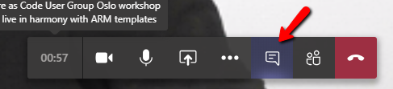

Practical information
Mute your mic (but don’t forget to unmute it if have a question or want to say something)
Feel free to use Video
Conversation
If you want to have private discussion, find evgeny@enso.no and start chat with me
Share screen

Slide 5
Practical information
Each lab is time-boxed
When you completed the lab, please post to the Conversation channel
lab-01
Labs are available after the event

Slide 6
Immutable infrastructure
Infrastructure as Code User Group Oslo
27.10.2020
Evgeny Borzenin

Slide 7


[VCE] Vipps Core Engine
VNet + NSG + peerings
AKS (> 100 services)
API Management ( > 100 APIs)
Application Gateway
And many more...
Notes:
9:00
What is VCE?
VCE is a set of infrastructure components trieated as one unit.
It consists of private Vnet with predefined set of subnets and assosiated Network Security Groups.
It also contain a set of Vnet peerings with some other Vnets to integrate with other internal systems, for example, to send logs to the centralized log storage.
AKS, where as I already said, 90% of workload is runninng. AKS is deployed to private VNEt, and is not publically accessibly.
To expose APIs, Api Management is used.
The API Management gateway is accessible only from within the virtual network.
To securely expose Internet-facing public APIs we use Application Gateway. APIM and AGW integration is well known pattern and it’s not in the scope of this session.
And a lot of other components of course, Azure Moonitor (with App Insight and Log Analytics), key vaults for secrets, storage accounts, AKS manahed identities just to name a few.
It’s very stripped view, but at the same time it gives us a sence of level of complexity we operate with.
Now let’s see with such a setup, what kind of operational tasks we may expect and what kind of challenges will it give us.

Slide 8
[VCE v1] maintenance: upgrade AKS cluster
Active Traffic
az aks upgrade --kubernetes-version 1.16.7
Notes:
1:30
The VCE journey started with DC/OS to AKS migration, when we provisioned AKS cluster, migrated all services, switched the traffic and the first version of VCE went life mid 2019.
One of the first thing you need to learn when working with AKS is the support model. AKS support model works the way that every time AKS product team releases a new major version, the support for some of the older versions is terminated. This way they help you keep your cluster up to date. That means that you should expect periodical AKS cluster upgrades to the newer version.
No excepion for us, and at some point we needed to upgrade our cluster to the next version.
Imagine that we are running AKS version 1.15.10 and we want to upgrade our cluster to version 1.16.7
You can do it from the postal, run an az cli command or deploy ARM template and boom! 3 hours later your cluster is upgraded.
Note, our cluster is still called aks-dev, irt’s still deployed to the same vnet and deployed to the same resource group with active production traffic

Slide 9
[VCE v1] replace AKS cluster
Active Traffic
add new aks-dev-v1 subnet
provision new aks-v1-dev cluster
deploy all services
test services
switch APIM towards aks-dev-v1
cleanup
Notes:
1:30
At some point we released that we did several wrong choices when we desiged our AKS cluster:
We selected basic networking model (we shoild of course use advanced)
We overprovisioned VM pool size
We used default OS disk size and that ccouses several networking issues
All 3 changes require cluster re-provisioning, because at that time AKS did support multiple VM pools
Several month later we realised that we need to reprovision new cluster.
In order to do it, we need new subnet, we need to provisoon and configure new cluster, we need to deploy all services to the new cluster, do some initial testing and finally switch the traffic.
Note. Even though, this time we provisioned new cluster, it’s still deployed to the same vnet under the same resource group with active traffic

Slide 10
[VCE v1] upgrade AGW to v2
Active Traffic
add new agw-v2-net subnet
provision new instance of AGW v2
test
send traffic to AGW v2
cleanup
Notes:
1:30
Sortly after VCE v1 went life, Application Gateway v2 was at GA.
First of all, they improved performance (updates take 6 min vs 20 min in v1),
and AGW v2 contains quite a few very practical features: like autoscaling, header rewrite, zone redundancy, and ability to read SSL certificate for httplisteners from the key-vault.
So, we diecided that we want to upgrade AGW to v2.
AGW v1 and v2 can’t be deployed to the same subnet, so we need to add new subnet.
We provision new instance of AGW v2
And we redirect traffic to the new instance of AGW
Note, this time we added new component to the existing changes are done at the same usergroup, same vnet with active production traffic

Slide 11
[VCE v1] retrospective
AKS upgrade
High risk operations
Maintenance window
High stress, fear to upgrade
Can’t do end-to-end testing
AKS re-provisioning
Low risk operation
Can’t do end-to-end testing
AGW v2
Low risk operation
Possible to do end-to-end testing
Can’t do canary testing
Notes:
1:30
All changes at v1 infra was done with active production traffic and that made them a hight risk changes. If something goes wrong it will immidiately affect our customers.
Becuase of that they needed to be planned in advanced, coordinated with Command Center and only be done at the dedicated maintenence windows. Normally at the weekend and at the middle of the night.
In addition to that, some of the changes, like AKS upgrade was a highly stresfull operations.
Prod cluster upgrade takes approx 3 hours to upgrade. Now imagine the person who is sitting at night and starting the upgrade. When he runs the script, for the next 3 hours, hes just sit and hope for the best.
It’s not possible to do end-to-end testing of he new cluster, becuase only one version of AKS can receive the trfafic and for the same reason, it’s not posible to do a canary testing.

Slide 12
Mutable infrastructure
Mutable means liable to change
Infrastructure that is capable of being modified and updated in-place on a regular basis
VCE v1 is mutable infrastructure
High risk operations
High stress, fear to upgrade
Maintenance window
Can’t do end-to-end testing
Notes:
2:30
Let’s define what mutable infrastructure is.
Mutable means that infrastructure that is capable of being modified in place on regular basis.
In our example, when we upgraded AKS from version 1.15.10 to 1.16.7 we mutated existing AKS cluster instance.
The same was with vnet. When we added new subnets to vnet, we changed the same instance of vnet in place.
What are the pros and cons of mutable infra?
Pros:
It’s simple. You provision it once and you changing it.
It’s fast to apply changes. Update AGW takes 20 min, provision new instance takes 45 min
Cons:
Configurational drift – we all know when infrastructure is changing in place, it’s very easy to do some shortcuts and apply changes from the portal and that leads to chaos.
There is a chance that upgrade will fail and then you can be out of business
It’s not possible to rollback upgrade, for instance if you upgrade AKS to version 1.16.7 and then found that something doesn’t work, you can’t rolleback to 1.15.10. You have to re-provision new cluster.

Slide 13
Immutable infrastructure
Immutable -> unchanging or unable to change
Once deployed, cannot be modified
VCE v1 is immutable
Notes:
1:30
“immutable” is the antonym of “mutable,” meaning “unchanging or unable to change.”
Immutable infrastructure is infrastructure that, once deployed, cannot be modified.
It allows you to test your infrastructure or your applications under the new infrastetucture before you opens it up for the users.
It allows you to do a canary testing, when you send small percentage of you traffic to the new version, observ the behavior and when everything is good, switch all traffic.
If new version doesn’t work well, you still have the old one available and you can switch your traffic back to the old infra.
Since we never update the infrastructure, configuration drinf technically not possible.
But it doesnt come for free. The cost is complexity. During the transition period. you will have twise more infrastructure components to maintain and monitor.
It requires heavy investment into automation. Provisioning, post-provisioning configuration and application deployment – everything should be fully automated.

Slide 14
[VCE vNext] upgrade life cycle
provision infra
deploy services
end-to-end test
canary test
switch
decommision
Notes:
2 min

Slide 15
[VCE vNext] upgrade life cycle
provision infra
deploy services
end-to-end test
canary test
switch
decommision
Notes:
1 min

Slide 16
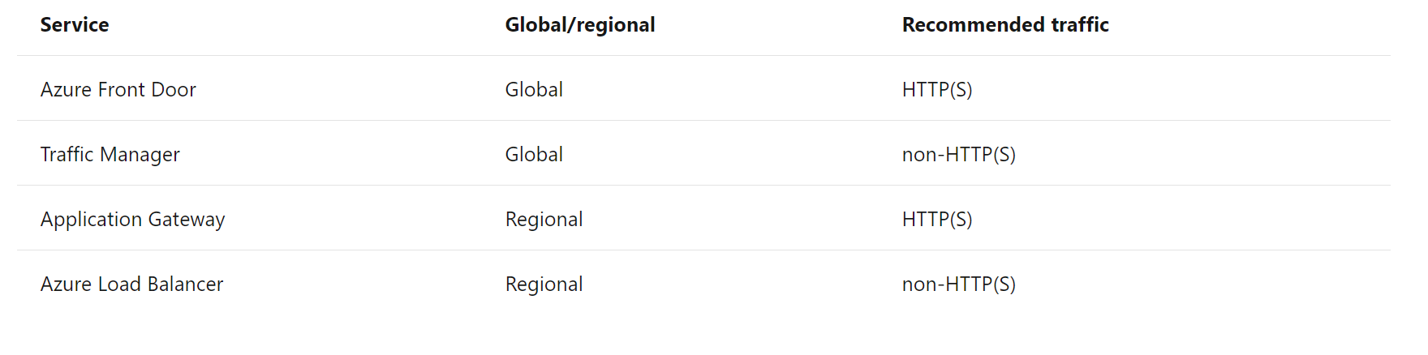
Azure load-balancing options
Front Doors *
Traffic Manager *
Application Gateway
Azure Load Balancer
https://docs.microsoft.com/en-us/azure/architecture/guide/technology-choices/load-balancing-overview
Notes:
Front Door is an application delivery network that provides global load balancing and site acceleration service for web applications. It offers Layer 7 capabilities for your application like SSL offload, path-based routing, fast failover, caching, etc. to improve performance and high-availability of your applications.
Traffic Manager is a DNS-based traffic load balancer that enables you to distribute traffic optimally to services across global Azure regions, while providing high availability and responsiveness. Because Traffic Manager is a DNS-based load-balancing service, it load balances only at the domain level. For that reason, it can't fail over as quickly as Front Door, because of common challenges around DNS caching and systems not honoring DNS TTLs.
Application Gateway provides application delivery controller (ADC) as a service, offering various Layer 7 load-balancing capabilities. Use it to optimize web farm productivity by offloading CPU-intensive SSL termination to the gateway.
Azure Load Balancer is a high-performance, low-latency Layer 4 load-balancing service (inbound and outbound) for all UDP and TCP protocols. It is built to handle millions of requests per second while ensuring your solution is highly available. Azure Load Balancer is zone-redundant, ensuring high availability across Availability Zones.

Slide 17
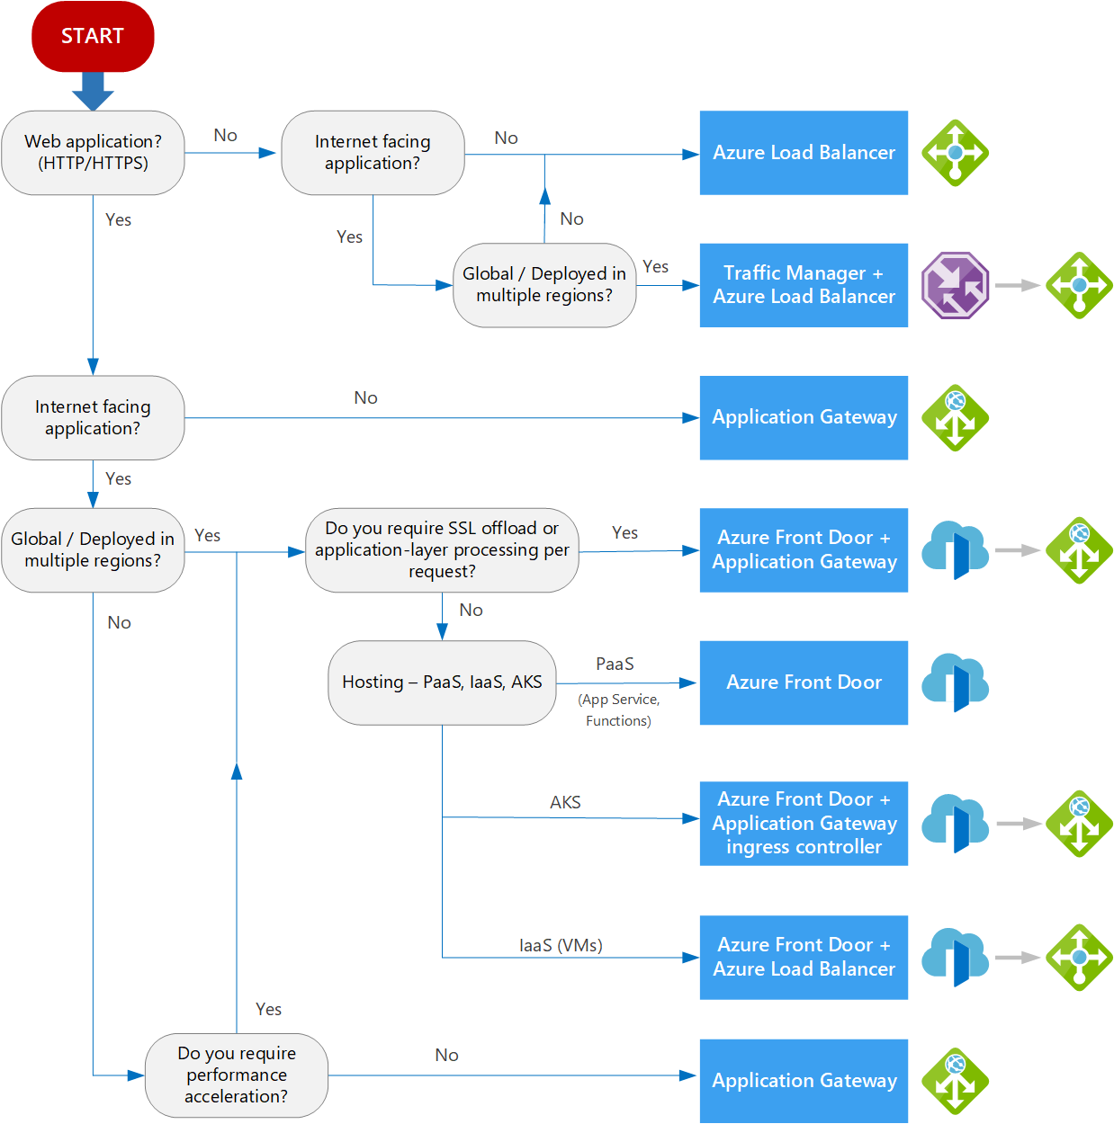
Azure load-balancing options
Front Doors
Traffic Manager
Application Gateway
Azure Load Balancer
https://docs.microsoft.com/en-us/azure/architecture/guide/technology-choices/load-balancing-overview

Slide 18
Today labs
LAB-01 – LAB-06

Slide 19



Use-case
Azure function
Consumption Plan
Deployed via Storage Account
Use AppInsights
Front Door
Azure DevOps as CI/CD

Slide 20
Use-case (MVP)
Active slot is green
Provision next slot (blue)
Switch traffic to blue
Decommission green
Active slot is blue
Next slot is green

Slide 21
Use-case: canary

Slide 22
Labs

Slide 23

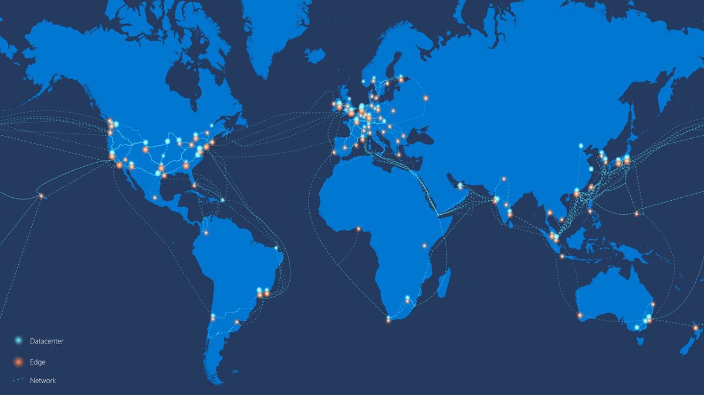
Front Door
Level 7 load balancer - HTTP(s)
Multiple-site hosting
Routing methods
Latency
Priority
Weighted
Session Affinity
https://docs.microsoft.com/en-us/azure/networking/microsoft-global-network
Notes:
Azure Front Door is a global HTTP\HTTPS load balancer that works at layer 7 provides.
Front Door then always routes traffic to the fastest available backend.
Once a packet enters the Azure global WAN, the request is sent over extremely low latency connection between any two points.
This speed cannot be matched on the public Internet where there would be many hops and much higher latency.
POP point of presence
The orange dots are edge sites that are utilized by the Azure Front Door.

Slide 24
Front Door
URL-based routing
Session affinity
Multiple-site hosting
TLS termination
Custom domains and certificate management
Routing methods
Latency
Priority
Weighted
Session Affinity
Notes:
Front Door is an application delivery network that provides global load balancing and site acceleration service for web applications. It offers Layer 7 capabilities for your application like SSL offload, path-based routing, fast failover, caching, etc. to improve performance and high-availability of your applications.
Traffic Manager is a DNS-based traffic load balancer that enables you to distribute traffic optimally to services across global Azure regions, while providing high availability and responsiveness. Because Traffic Manager is a DNS-based load-balancing service, it load balances only at the domain level. For that reason, it can't fail over as quickly as Front Door, because of common challenges around DNS caching and systems not honoring DNS TTLs.
Application Gateway provides application delivery controller (ADC) as a service, offering various Layer 7 load-balancing capabilities. Use it to optimize web farm productivity by offloading CPU-intensive SSL termination to the gateway.
Azure Load Balancer is a high-performance, low-latency Layer 4 load-balancing service (inbound and outbound) for all UDP and TCP protocols. It is built to handle millions of requests per second while ensuring your solution is highly available. Azure Load Balancer is zone-redundant, ensuring high availability across Availability Zones.

Slide 25
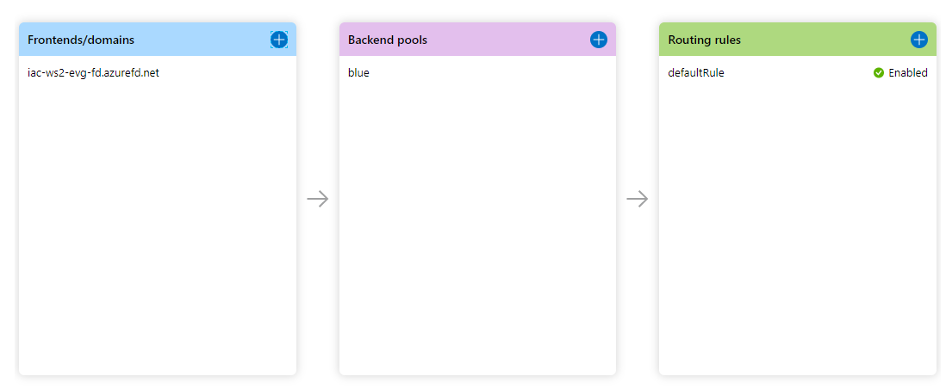
Front Door
Notes:
Front Door is an application delivery network that provides global load balancing and site acceleration service for web applications. It offers Layer 7 capabilities for your application like SSL offload, path-based routing, fast failover, caching, etc. to improve performance and high-availability of your applications.
Traffic Manager is a DNS-based traffic load balancer that enables you to distribute traffic optimally to services across global Azure regions, while providing high availability and responsiveness. Because Traffic Manager is a DNS-based load-balancing service, it load balances only at the domain level. For that reason, it can't fail over as quickly as Front Door, because of common challenges around DNS caching and systems not honoring DNS TTLs.
Application Gateway provides application delivery controller (ADC) as a service, offering various Layer 7 load-balancing capabilities. Use it to optimize web farm productivity by offloading CPU-intensive SSL termination to the gateway.
Azure Load Balancer is a high-performance, low-latency Layer 4 load-balancing service (inbound and outbound) for all UDP and TCP protocols. It is built to handle millions of requests per second while ensuring your solution is highly available. Azure Load Balancer is zone-redundant, ensuring high availability across Availability Zones.

Slide 26
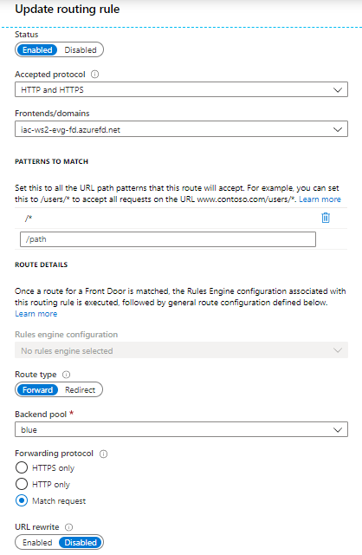
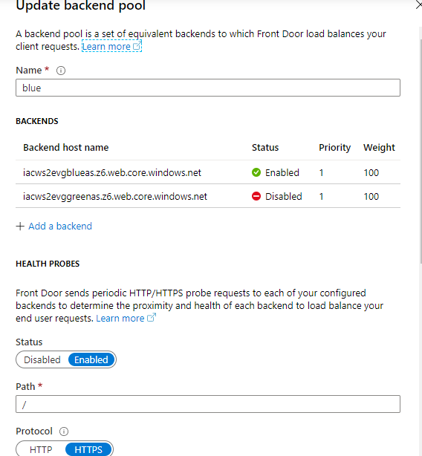
Front Door
Notes:
Front Door is an application delivery network that provides global load balancing and site acceleration service for web applications. It offers Layer 7 capabilities for your application like SSL offload, path-based routing, fast failover, caching, etc. to improve performance and high-availability of your applications.
Traffic Manager is a DNS-based traffic load balancer that enables you to distribute traffic optimally to services across global Azure regions, while providing high availability and responsiveness. Because Traffic Manager is a DNS-based load-balancing service, it load balances only at the domain level. For that reason, it can't fail over as quickly as Front Door, because of common challenges around DNS caching and systems not honoring DNS TTLs.
Application Gateway provides application delivery controller (ADC) as a service, offering various Layer 7 load-balancing capabilities. Use it to optimize web farm productivity by offloading CPU-intensive SSL termination to the gateway.
Azure Load Balancer is a high-performance, low-latency Layer 4 load-balancing service (inbound and outbound) for all UDP and TCP protocols. It is built to handle millions of requests per second while ensuring your solution is highly available. Azure Load Balancer is zone-redundant, ensuring high availability across Availability Zones.

